Slide 1
PSP0 Process
PSP0 is a simple, defined, personal process.
  Make a plan.
  Use your current design and development methods to produce a small program.
  Gather time and defect data on your work.
  Prepare a summary report.

Slide 2
PSP0 Objective
The objective for PSP0 is to
  demonstrate the use of a defined process in writing small programs
  incorporate basic measurements in the software development process
  require minimal changes to your personal practices

Slide 3
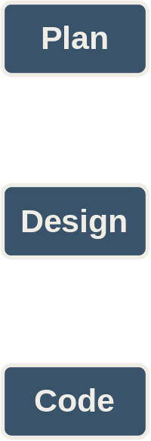
PSP0 Process Phases -1
PSP0 has six phases.
Planning – produces a plan for developing the program defined by the requirements.
Design – produces a design specification for the program defined by the requirements.
Coding – transforms the design specification into programming language statements.

Slide 4
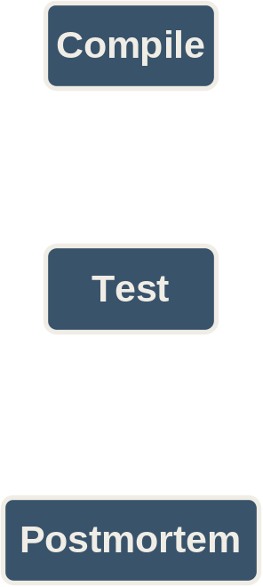
PSP0 Process Phases -2
Compile – translates the programming language statements into executable code.
Test – verifies that the executable code satisfies the requirements.
Postmortem – summarizes and analyzes the project data.

Slide 5
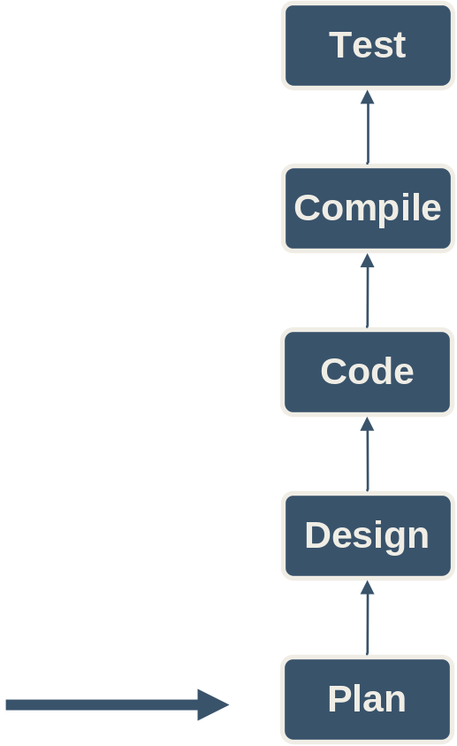
Phase Order
Phase order is determined by the dependencies between phases.
  You can’t test the code before it’s compiled.
  You can’t compile the code before it’s written.
  You can’t use the design if it’s produced after the code is written.
  There’s no reason to make a plan after you’re done.
You should start here

Slide 6
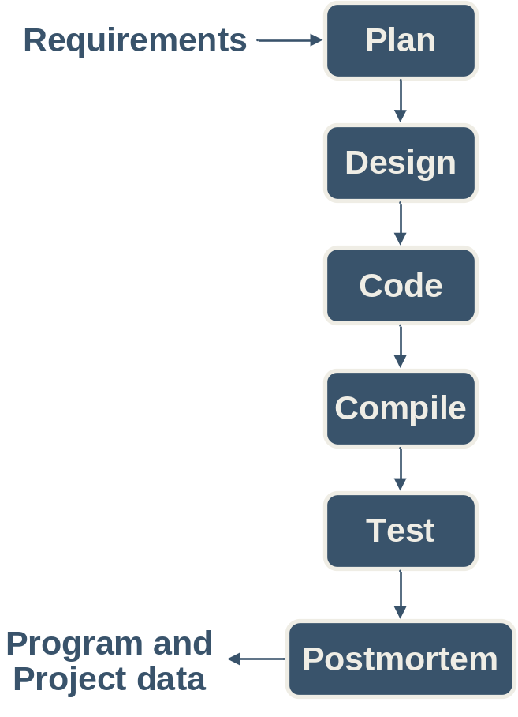
Process Flow
For programs that are small or well understood, execute the phases in order.
Product a plan.
Design all modules.
Code all modules.
Compile the coded program.
Summarize the project data during the postmortem.

Slide 7
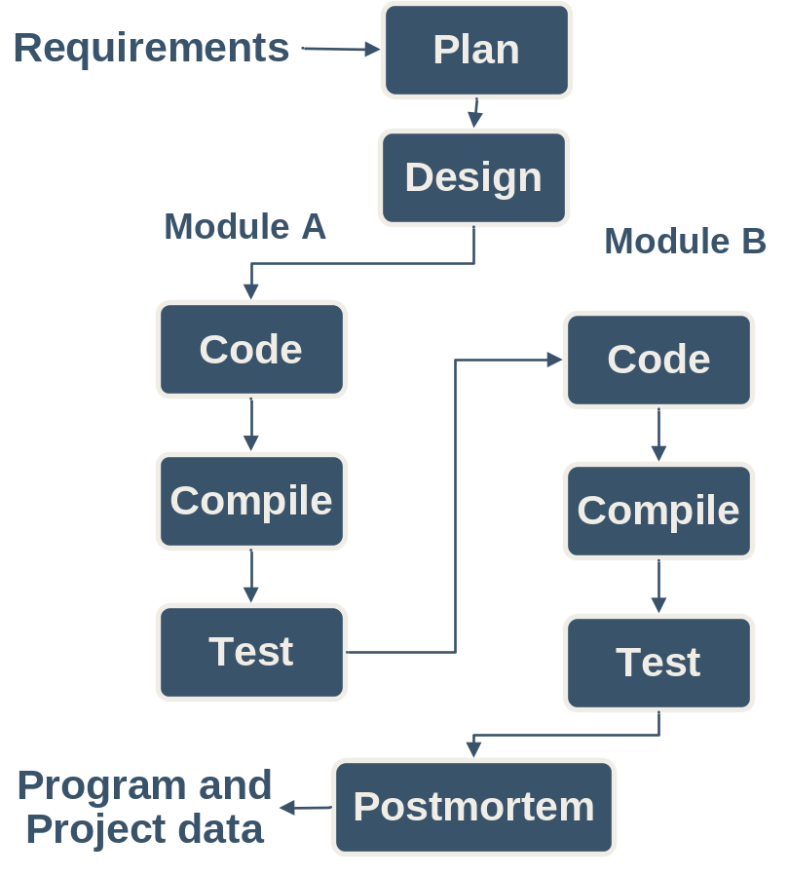
Cyclic Process Flow -1
Some programs may require an iterative approach.
In this example the design is completed in one step.
Two modules are identified during the design, modules A and B.
Then each module is separately coded, compiled, and tested.
This example uses the PSP0 phases and two cycles of code-compile-test.

Slide 8
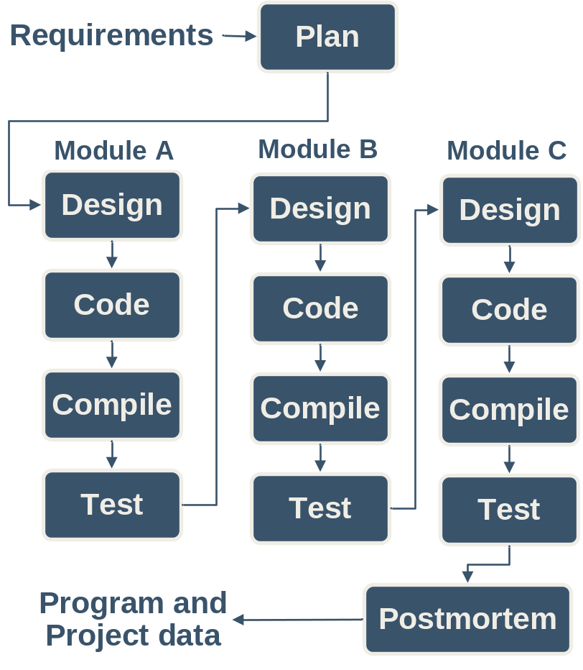
Cyclic Process Flow -2
There can be more than two cycles and cycles can also include the design phase as in this example.
Note that each cycle is focused on producing part of the program, e.g. Module A, Module B, Module C.
Part size is a key factor for determining cycles.
  a line of code is too small
  a program may be too large
One or more classes, methods, procedures, functions, etc. are the appropriate size part for a cycle.

Slide 9
The PSP0 Scripts -1
Planning: Estimate the development time.
Development: Develop the product using your current methods.
Postmortem: Complete the project plan summary with the time spent and defects found and injected in each phase.

Slide 10

Measurement in the Cyclic Process
Considerations
  Include a program part identifier in the notes field on time log entries.
  Add a similar annotation to defect log entries.
  Use “Test” as the phase removed when defects are found in a previously tested part.
Example
Tom finds and fixes an interface error in part A of his program while coding part B.
Q: In what PSP phase was this defect removed?
A: Test

